Slide 1
Graph
Convolution
Network
모바일시스템공학과
32181928 박찬호

Slide 2
Contents
1. Introduction
a. Deep Learning
b. Convolutional Neural Network
c. Graph Neural Network
2. Graph Convolution
3. Spectral vs Spatial Convolution
a. Fourier Transform
b. Laplacian to Fourier Transform
4. Cluster-GCN
a. Gradient Descent
b. Cluster-GCN
5. Application
a. Two-hand Reconstruction
6. References

Slide 3
Contents
1. Introduction
a. Deep Learning
b. Convolutional Neural Network
c. Graph Neural Network
2. Graph Convolution
3. Spectral vs Spatial Convolution
a. Fourier Transform
b. Laplacian to Fourier Transform
4. Cluster-GCN
a. Gradient Descent
b. Cluster-GCN
5. Application
a. Two-hand Reconstruction
6. References

Slide 4
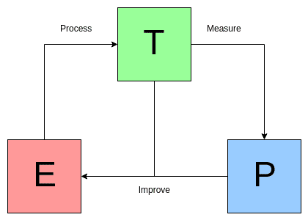
Machine Learning
Machine Learning
A computer program is said to learn from experience E with respect to some class of tasks T and performance measure P, if its performance at tasks in T, as measured by P, improves with experience E. Tom Mitchell
https://www.kdnuggets.com/2018/10/mitchell-paradigm-concise-explanation-learning-algorithms.html

Slide 5
Deep Learning
A part of Machine Learning
Artificial Neural Network
Multiple hidden layers → Deep Neural Network (DNN)
Key to Representation Learning
Learning representation of raw data
For computer to process specific task
Simple representation to complex concepts

Slide 6
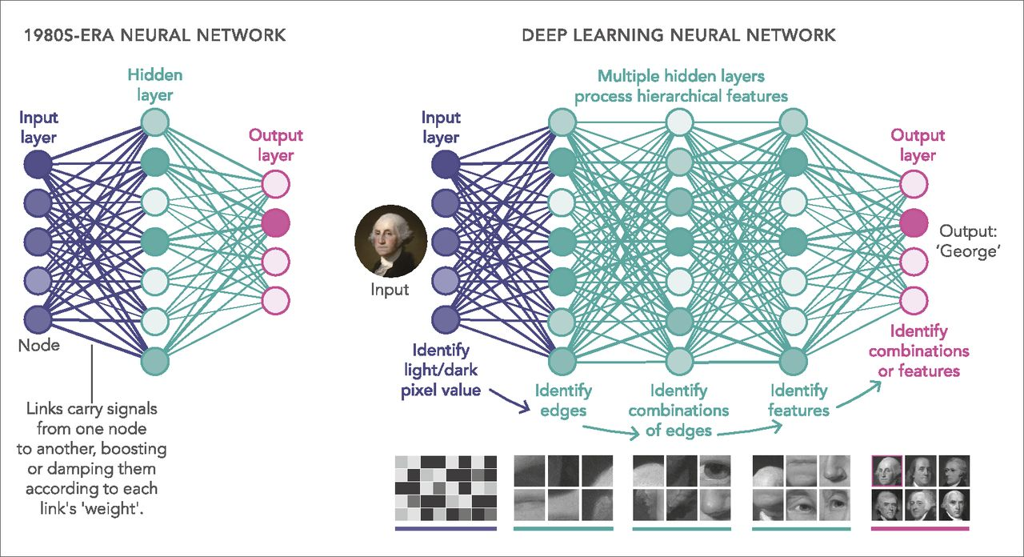
Deep Learning
A part of Machine Learning
Artificial Neural Network
Multiple hidden layers → Deep Neural Network (DNN)
Key to Representation Learning
Learning representation of raw data
For computer to process specific task
Simple representation to complex concepts
https://www.pnas.org/doi/full/10.1073/pnas.1821594116

Slide 7
Contents
1. Introduction
a. Deep Learning
b. Convolutional Neural Network
c. Graph Neural Network
2. Graph Convolution
3. Spectral vs Spatial Convolution
a. Fourier Transform
b. Laplacian to Fourier Transform
4. Cluster-GCN
a. Gradient Descent
b. Cluster-GCN
5. Application
a. Two-hand Reconstruction
6. References

Slide 8
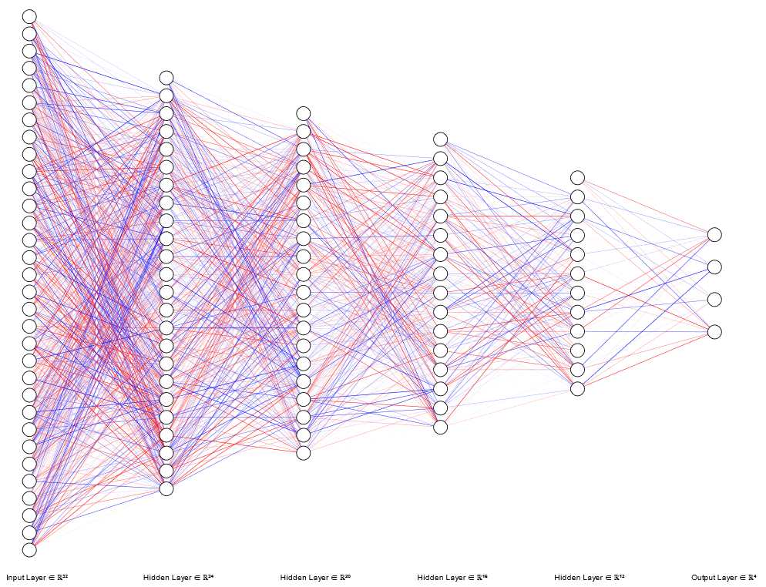
Problems of DNN == Motivation of CNN
Network consists of Fully-Connected Layers
Every output unit interacts with every input unit
Small features like edges occupy only tens or hundreds of pixels
Each element of the weight matrix is used exactly once
= learning a separate set of parameters for every location

Slide 9

Problems of DNN == Motivation of CNN
Network consists of Fully-Connected Layers
Every output unit interacts with every input unit
Small features like edges occupy only tens or hundreds of pixels
Each element of the weight matrix is used exactly once
= learning a separate set of parameters for every location

Slide 10
Problems of DNN == Motivation of CNN
Network consists of Fully-Connected Layers
Every output unit interacts with every input unit
Small features like edges occupy only tens or hundreds of pixels
Each element of the weight matrix is used exactly once
= learning a separate set of parameters for every location

Slide 11
Problems of DNN == Motivation of CNN
Network consists of Fully-Connected Layers
Every output unit interacts with every input unit
Small features like edges occupy only tens or hundreds of pixels
Each element of the weight matrix is used exactly once
= learning a separate set of parameters for every location

Slide 12
Ideas of Convolution
Every output unit interacts with every input unit
Small features like edges occupy only tens or hundreds of pixels
→ Sparse Interaction = Small kernels
Each element of the weight matrix is used exactly once
= learning a separate set of parameters for every location
→ Parameter Sharing

Slide 13
Sparse Interaction
Kernels are smaller than input
→ Less memory usage
→ Less computation

Slide 14
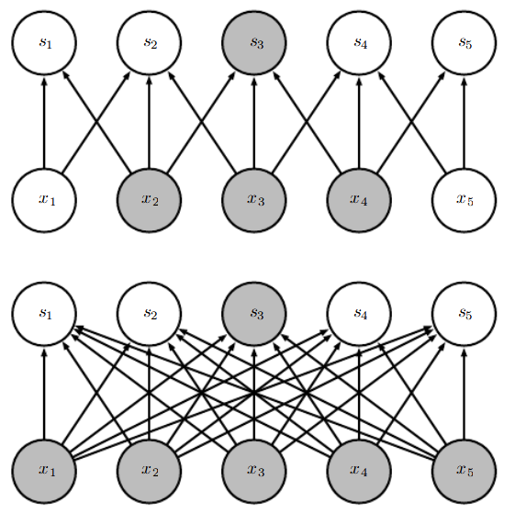
Sparse Interaction
Sparse Interaction
Kernels are smaller than input
→ Less memory usage
→ Less computation
Deep Neural Network

Slide 15
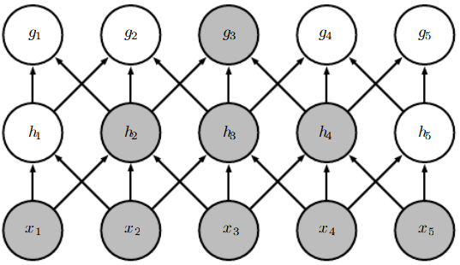
Sparse Interaction
Sparse Interaction in Deeper Layers
Kernels are smaller than input
→ Less memory usage
→ Less computation

Slide 16
Parameter Sharing
Using same parameters for different
functions in model
→ Smaller num of parameters to save

Slide 17
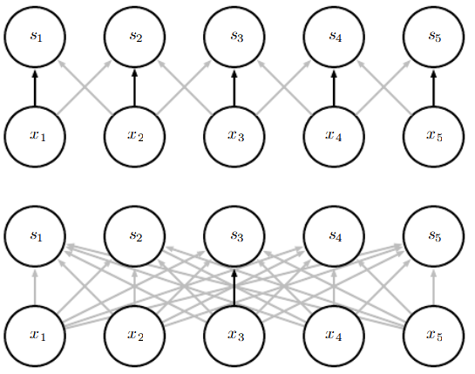
Parameter Sharing
Parameter Sharing
Using same parameters for different
functions in model
→ Smaller num of parameters to save
Deep Neural Network

Slide 18
Parameter Sharing
Parameter Sharing
Using same parameters for different
functions in model
→ Smaller num of parameters to save
CONVOLUTION!
Deep Neural Network

Slide 19

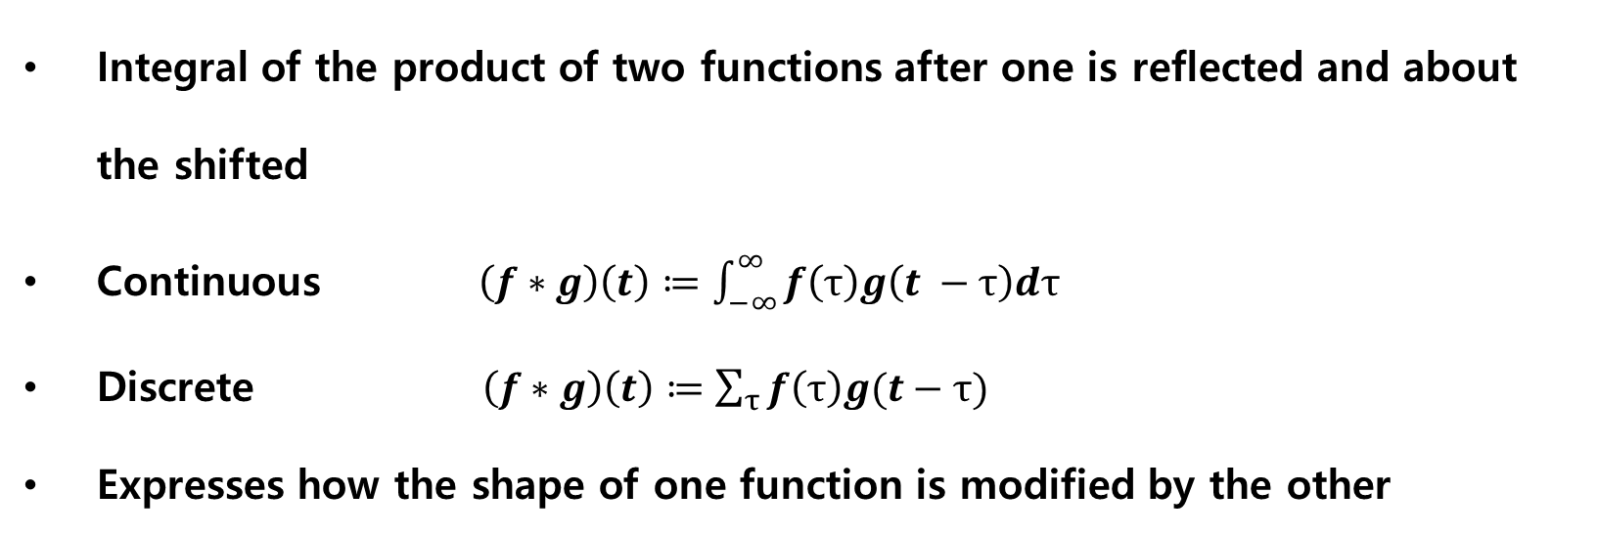
Convolution?
Integral of the product of two functions after one is reflected and about the shifted
Continuous $\left(f∗g\right)\left(t\right)≔\int_{−∞}^{∞}{f\left(τ\right)g\left(t −τ\right)dτ}$
Discrete $\left(f∗g\right)\left(t\right)≔\sum_{τ}{f\left(τ\right)g(t−τ)}$
Expresses how the shape of one function is modified by the other
https://commons.wikimedia.org/wiki/File:Convolution_of_spiky_function_with_box.gif

Slide 20
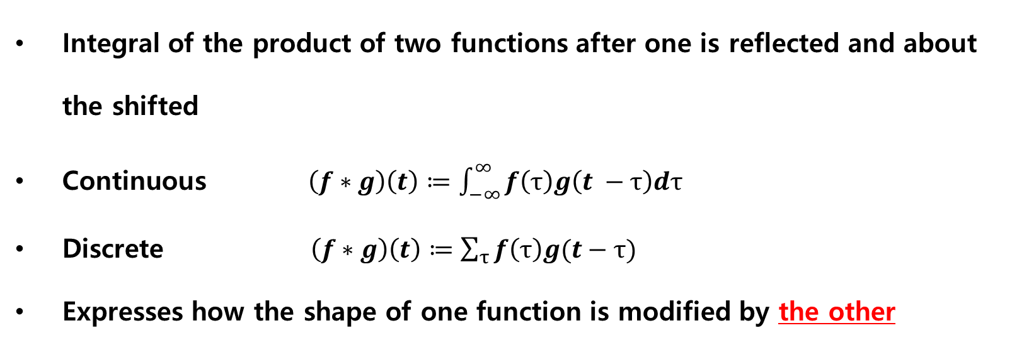
Convolution?
Integral of the product of two functions after one is reflected and about the shifted
Continuous $\left(f∗g\right)\left(t\right)≔\int_{−∞}^{∞}{f\left(τ\right)g\left(t −τ\right)dτ}$
Discrete $\left(f∗g\right)\left(t\right)≔\sum_{τ}{f\left(τ\right)g(t−τ)}$
Expresses how the shape of one function is modified by the other
Kernel (Filter)
https://commons.wikimedia.org/wiki/File:Convolution_of_spiky_function_with_box.gif

Slide 21
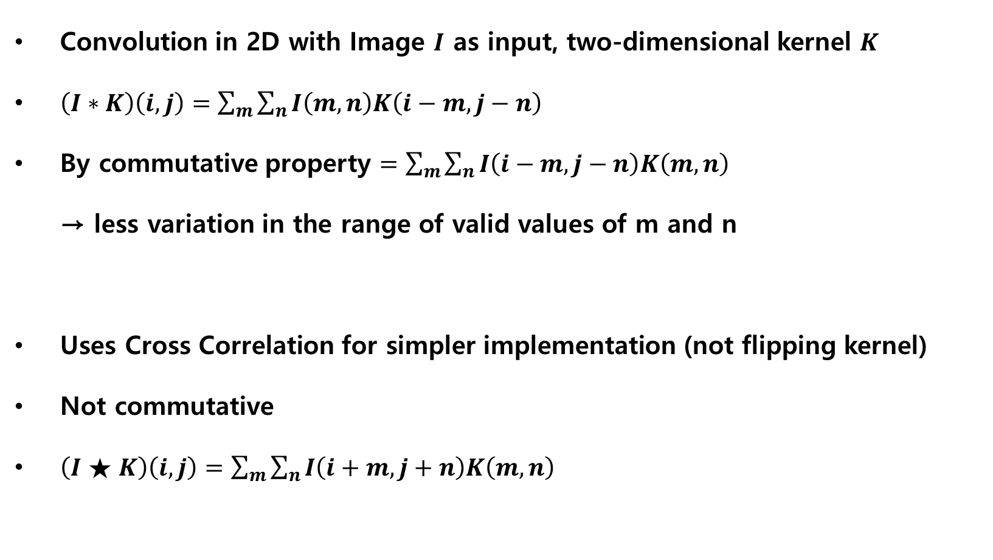
Convolution in CNN
Convolution in 2D with Image $I$ as input, two-dimensional kernel $K$
$\left(I∗K\right)\left(i, j\right)=\sum_{m}{\sum_{n}{I\left(m,n\right)K\left(i−m, j−n\right)}}$
By commutative property $=\sum_{m}{\sum_{n}{I\left(i−m,j−n\right)K\left(m, n\right) }}$
→ less variation in the range of valid values of m and n
Uses Cross Correlation for simpler implementation (not flipping kernel)
Not commutative
$\left(I★K\right)\left(i, j\right)=\sum_{m}{\sum_{n}{I\left(i+m,j+n\right)K\left(m, n\right) }}$

Slide 22
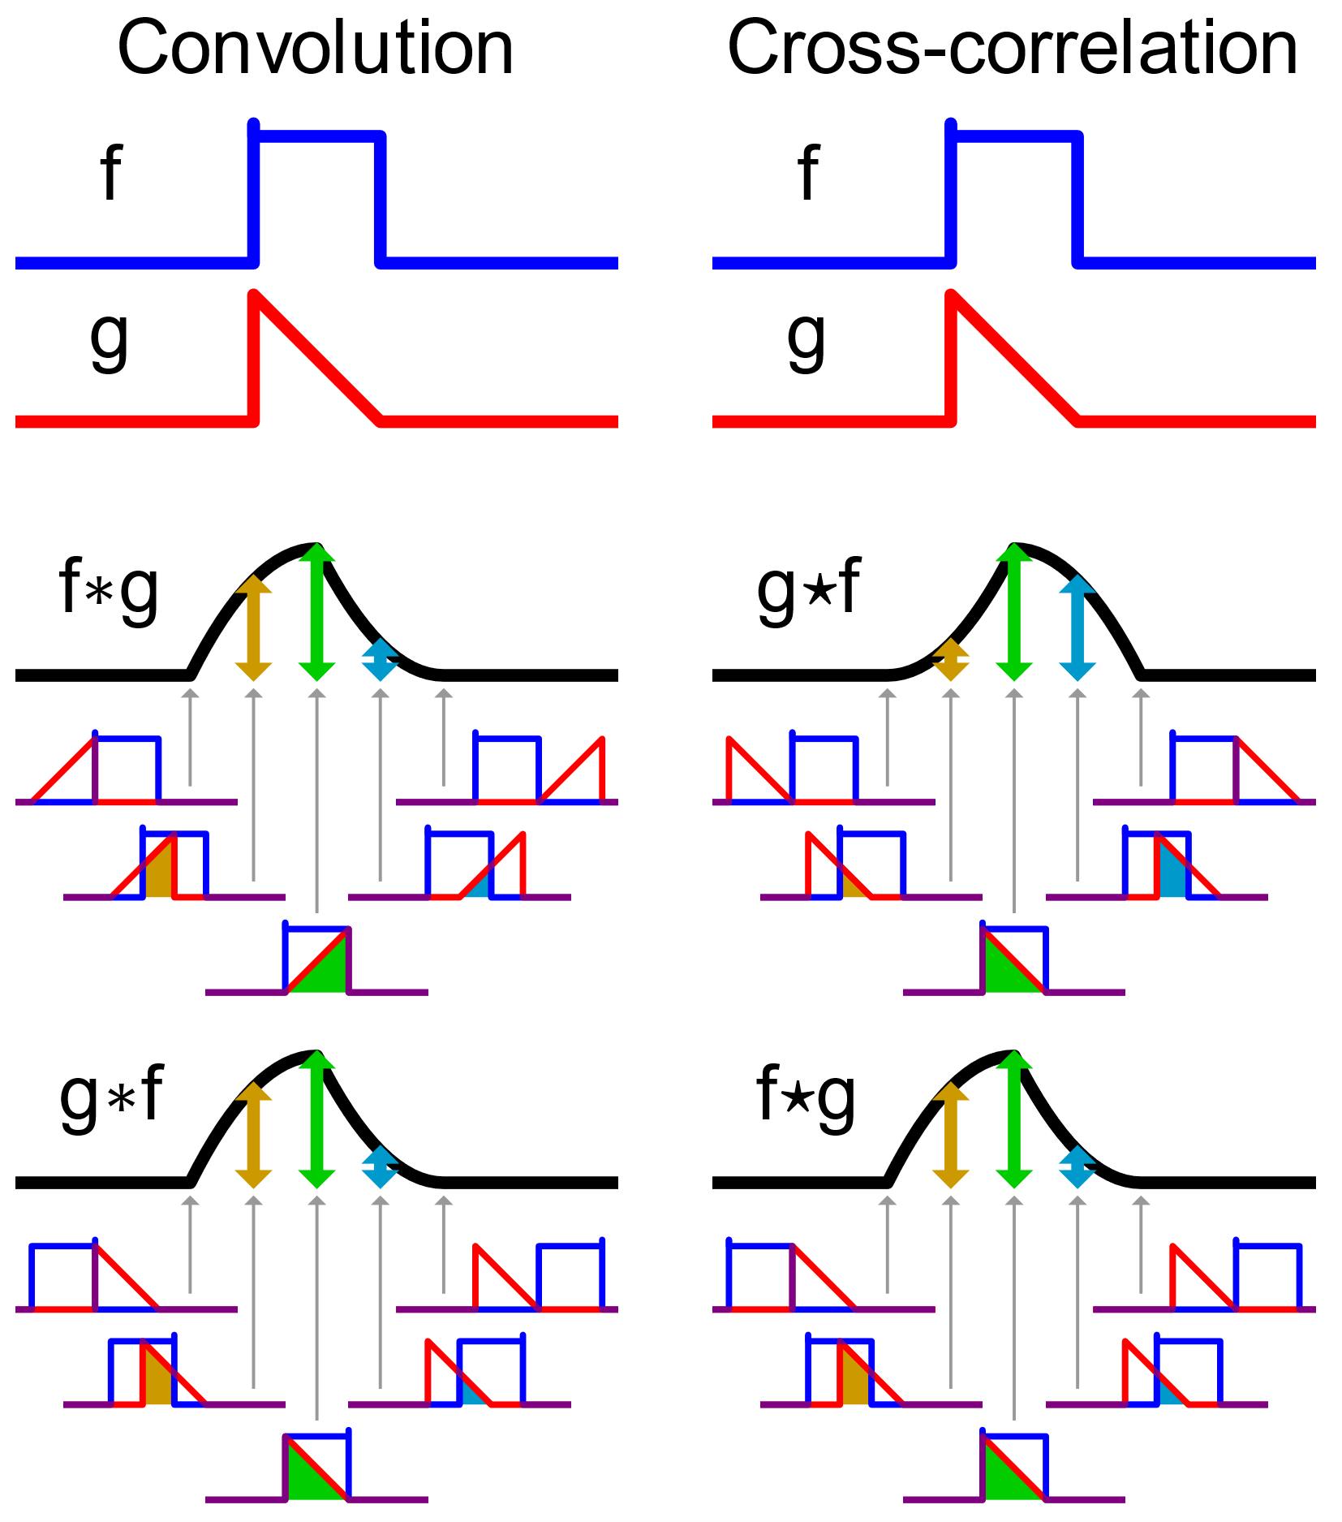
Convolution in CNN
Convolution in 2D with Image $I$ as input, two-dimensional kernel $K$
$\left(I∗K\right)\left(i, j\right)=\sum_{m}{\sum_{n}{I\left(m,n\right)K\left(i−m, j−n\right)}}$
By commutative property $=\sum_{m}{\sum_{n}{I\left(i−m,j−n\right)K\left(m, n\right) }}$
→ less variation in the range of valid values of m and n
Uses Cross Correlation for simpler implementation (not flipping kernel)
Not commutative
$\left(I★K\right)\left(i, j\right)=\sum_{m}{\sum_{n}{I\left(i+m,j+n\right)K\left(m, n\right) }}$

Slide 23
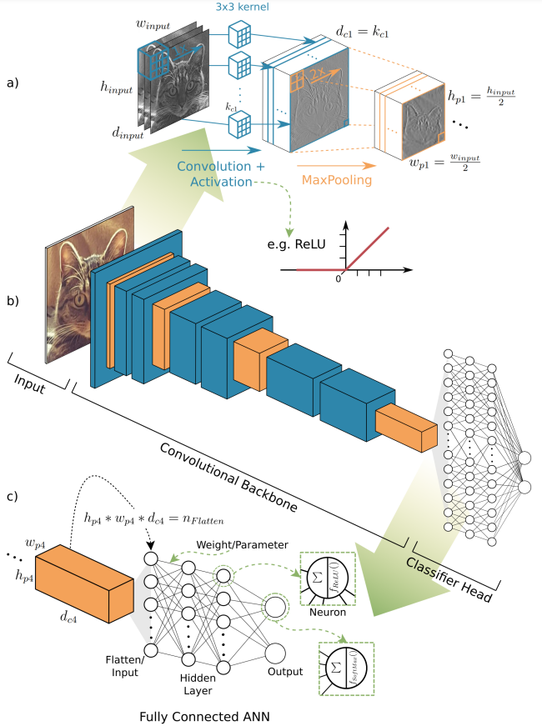
CNN
Convolution > Activation > Pooling
Convolution
Activation : nonlinear activation function
Pooling :
Summary statistics of output
ex) Max Pooling -> getting maximum
output within a rectangular neighbor
Translation invariance
<Object Detection and Image Segmentation with Deep Learning on Earth Observation Data: A Review-Part I: Evolution and Recent Trends> Thorsten Hoeser, Claudia Kuenzer

Slide 24


CNN
Convolution > Activation > Pooling
Convolution
Activation : nonlinear activation function
Pooling :
Summary statistics of output
ex) Max Pooling -> getting maximum
output within a rectangular neighbor
Translation invariance

Slide 25
CNN
Convolution > Activation > Pooling
Convolution
Activation : nonlinear activation function
Pooling :
Summary statistics of output
ex) Max Pooling -> getting maximum
output within a rectangular neighbor
Translation invariance
<Object Detection and Image Segmentation with Deep Learning on Earth Observation Data: A Review-Part I: Evolution and Recent Trends> Thorsten Hoeser, Claudia Kuenzer

Slide 26
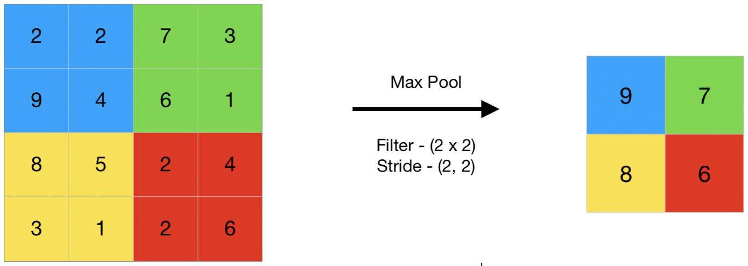
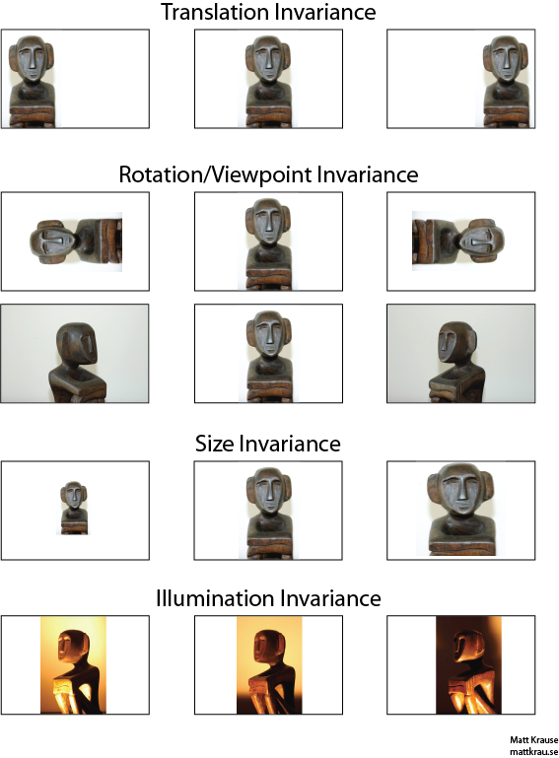
CNN
Convolution > Activation > Pooling
Convolution
Activation : nonlinear activation function
Pooling :
Summary statistics of output
ex) Max Pooling -> getting maximum
output within a rectangular neighbor
Translation invariance

Slide 27
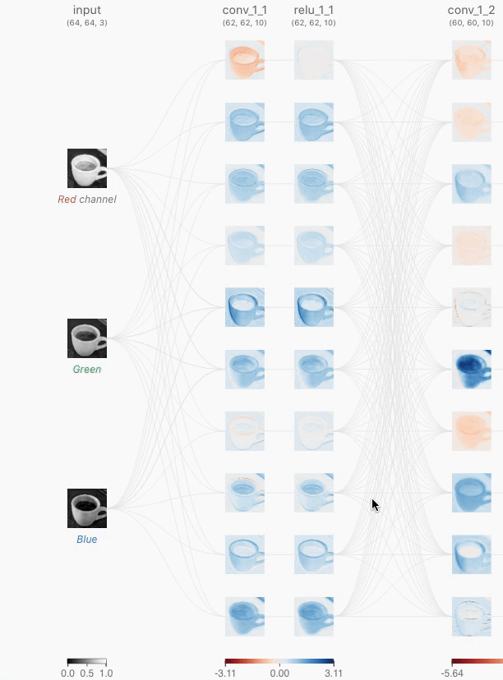
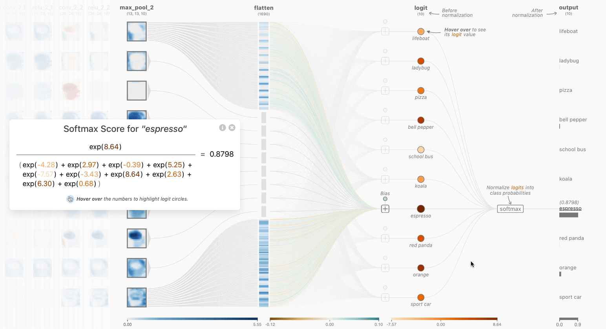
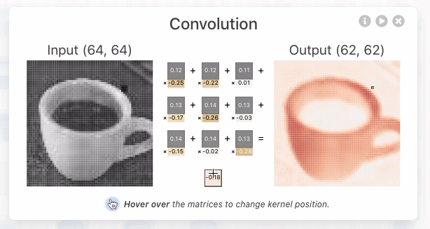
CNN
CNN Explainer
https://poloclub.github.io/cnn-explainer/

Slide 28
Contents
1. Introduction
a. Deep Learning
b. Convolutional Neural Network
c. Graph Neural Network
2. Graph Convolution
3. Spectral vs Spatial Convolution
a. Fourier Transform
b. Laplacian to Fourier Transform
4. Cluster-GCN
a. Gradient Descent
b. Cluster-GCN
5. Application
a. Two-hand Reconstruction
6. References

Slide 29
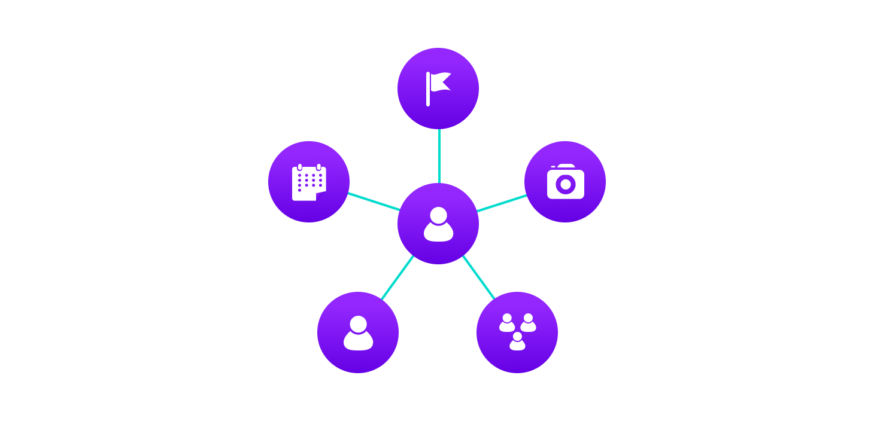
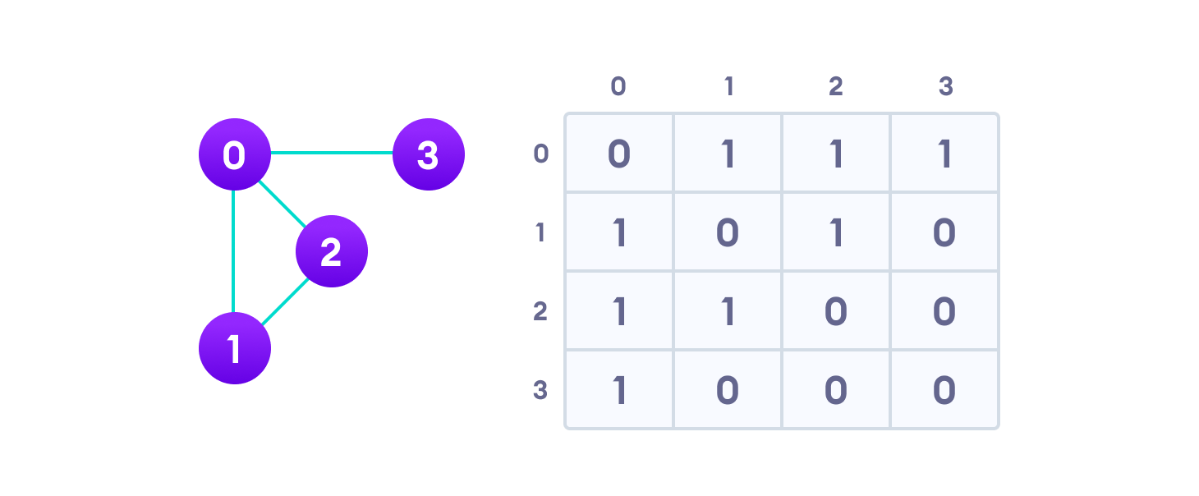
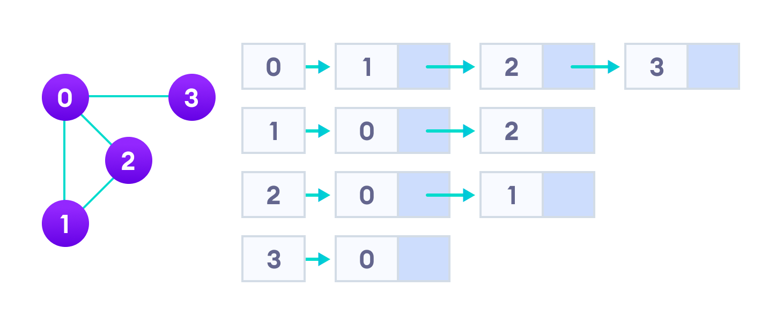
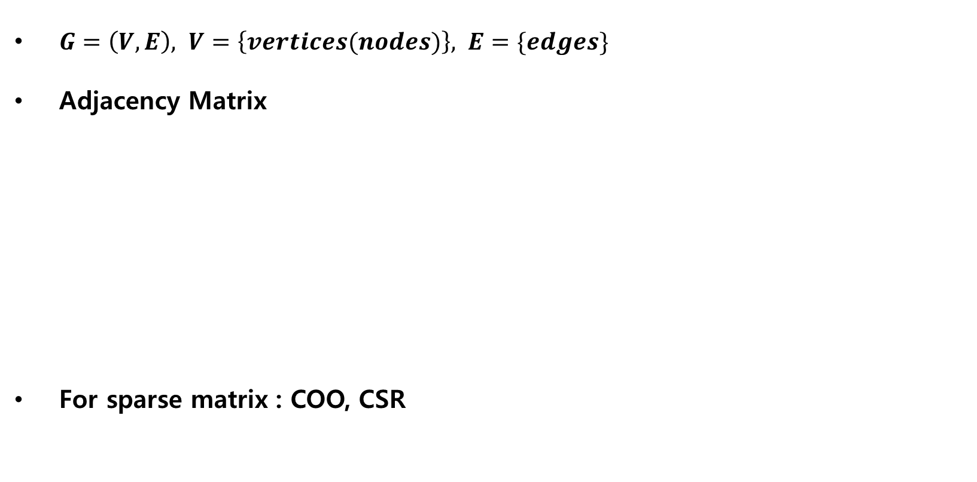
Graph Data Structure
Edge
Vertex (Node)
$G=\left(V, E\right), V=\left\{vertices(nodes)\right\}, E=\{edges\}$
Adjacency Matrix
For sparse matrix : COO, CSR
Graph
Adjacency list
https://www.programiz.com/dsa/graph

Slide 30
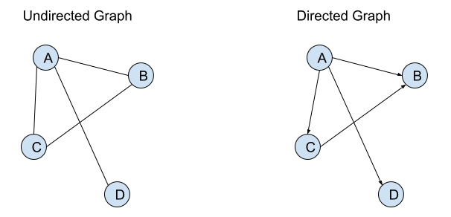
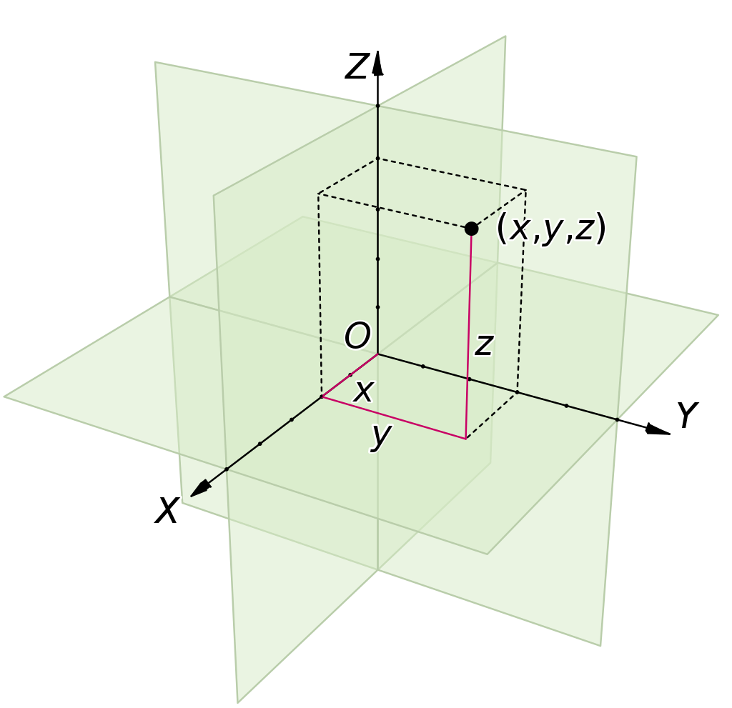
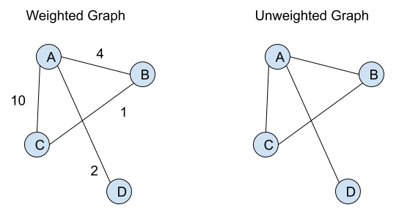
Graph Data Structure
https://nycomdorics.com/?s=graph
Directed-Undirected
Weighted-Unweighted
Graph
→ Good to represent relation between objects
→ Objects : Relations = Nodes : Edges
→ not in Euclidean Space == not in x-axis, y-axis …
https://en.wikipedia.org/wiki/Euclidean_space

Slide 31
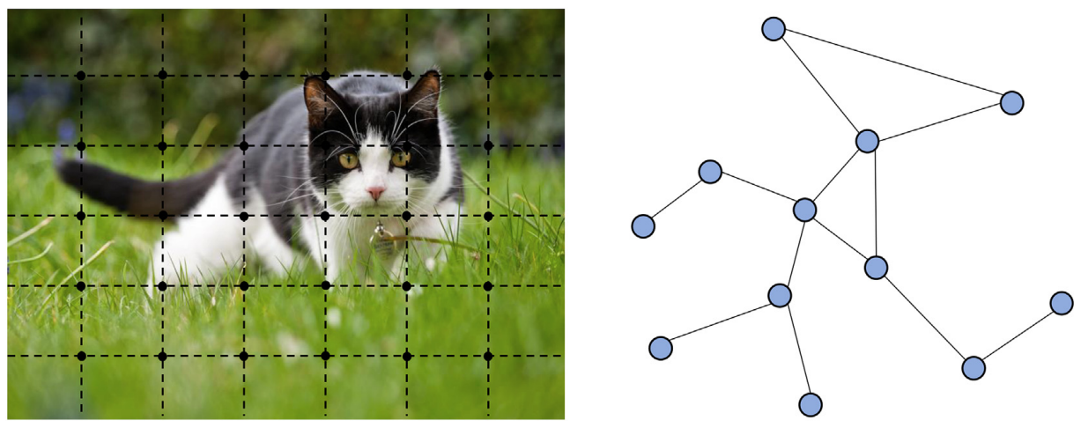
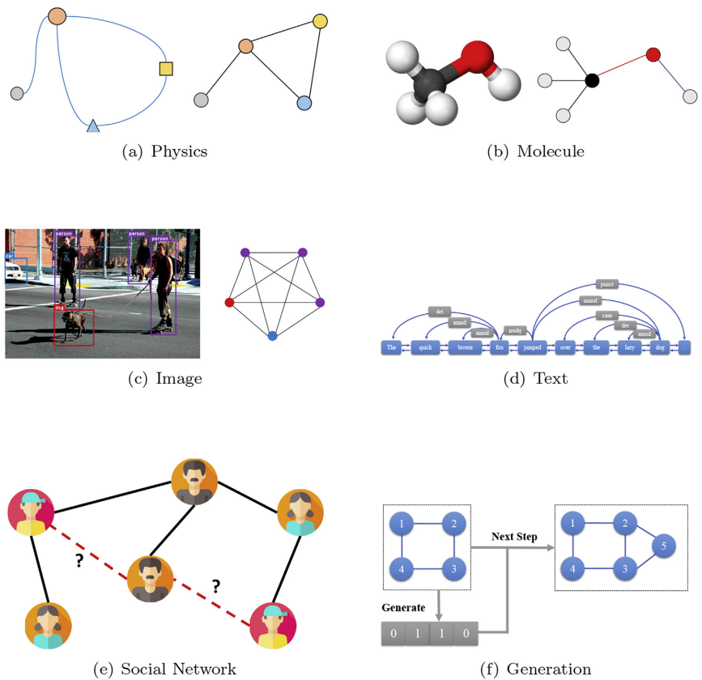
Graph Neural Network
Neural Network for Graph
Non-Euclidean data / Relation
CNN, RNN …
→ Models in Euclidean Space
→ Cannot be directly applied to Graph
Neural Network for Non-Euclidean Space Data
Image (Euclidean Data)
Graph (Non-Euclidean data)
<Graph neural networks: A review of methods and applications> Zhou et al.

Slide 32
Graph Neural Network
Traditional graph analysis methods
Search (BFS, DFS), Clustering
Shortest path (Dijkstra’s etc.)
Pagerank
→ Needs information of Graph
→ Graph Neural Network
Image (Euclidean Data)
Graph (Non-Euclidean data)
<Graph neural networks: A review of methods and applications> Zhou et al.

Slide 33
Tasks for GNN
Node level
Node classification, node regression, node clustering …
Edge level
Edge classification, link prediction …
Graph level
Graph classification, graph regression …
<Graph neural networks: A review of methods and applications> Zhou et al.

Slide 34
QUESTION?

Slide 35
Contents
1. Introduction
a. Deep Learning
b. Convolutional Neural Network
c. Graph Neural Network
2. Graph Convolution
3. Spectral vs Spatial Convolution
a. Fourier Transform
b. Laplacian to Fourier Transform
4. Cluster-GCN
a. Gradient Descent
b. Cluster-GCN
5. Application
a. Two-hand Reconstruction
6. References

Slide 36
Graph Convolution Network
<Semi-Supervised Classification with Graph Convolutional Networks>
T. N. Kipf, M. Welling / ICLR 2017 / ( https://arxiv.org/abs/1609.02907 )
Semi-Supervised : representations of nodes both with and without labels
Classification : Graph or Node Classification
Ex) In social network service,
Node 9, 10, 12, 16 are normal users
Node 11, 13, 15 are spammers
<Graph neural networks: A review of methods and applications> Zhou et al.

Slide 37
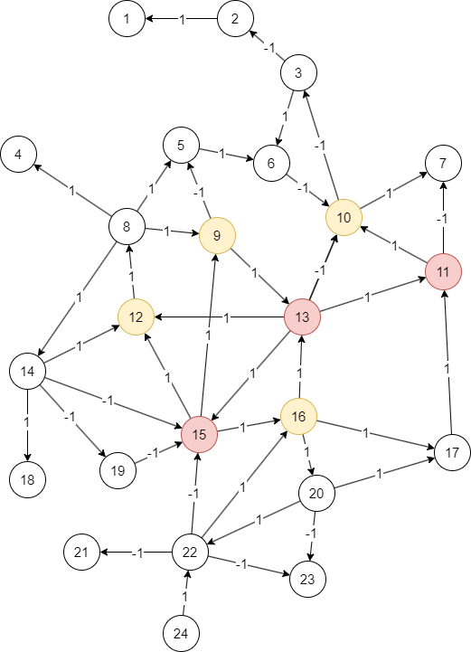
Graph Convolution Network
<Semi-Supervised Classification with Graph Convolutional Networks>
T. N. Kipf, M. Welling / ICLR 2017 / ( https://arxiv.org/abs/1609.02907 )
Semi-Supervised : representations of nodes both with and without labels
Classification : Graph or Node Classification
Ex) In social network service,
Node 9, 10, 12, 16 are normal users
Node 11, 13, 15 are spammers
Node classification of nodes without label
<Graph neural networks: A review of methods and applications> Zhou et al.

Slide 38
Graph Convolution Network
<Semi-Supervised Classification with Graph Convolutional Networks>
T. N. Kipf, M. Welling / ICLR 2017 / ( https://arxiv.org/abs/1609.02907 )
Graph Convolution ….?
<Graph neural networks: A review of methods and applications> Zhou et al.

Slide 39
2D Convolution to Graph Adjacency Matrix
2D Convolution
Euclidean Space
Near by elements in grid share similar feature
Graph
Non-Euclidean Space
Near by elements in matrix doesn’t share similar features

Slide 40
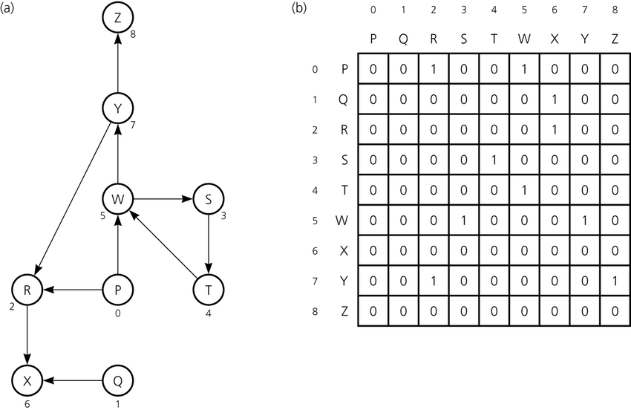
2D Convolution to Graph Adjacency Matrix
2D Convolution to graph cannot be applied
https://www.researchgate.net/figure/a-A-directed-graph-and-b-its-adjacency-matrix_fig2_239491573

Slide 41
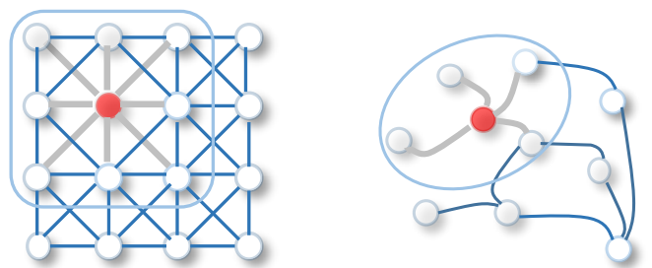
2D Convolution to Graph Adjacency Matrix
2D Convolution to graph cannot be applied
<A Comprehensive Survey on Graph Neural Networks> Wu et al.

Slide 42
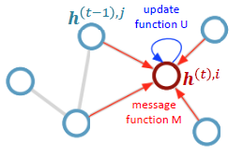
Idea of Graph Convolution
Message passing between nodes
Send and receive node features
https://ngkim.tistory.com/121
<A Comprehensive Survey on Graph Neural Networks> Wu et al.

Slide 43
Graph Convolution
2
3
Data
Node Feature
Adjacency Matrix A
Node Label
1
4
https://github.com/heartcored98/Standalone-DeepLearning/blob/master/Lec9/Lec9-A.pdf

Slide 44
Graph Convolution
2
3
Data
Node Feature
Adjacency Matrix A
Node Label
1
4
https://github.com/heartcored98/Standalone-DeepLearning/blob/master/Lec9/Lec9-A.pdf

Slide 45
Graph Convolution
2
3
Data
Node Feature
Adjacency Matrix A
Node Label
1
4
 | 1 | 2 | 3 | 4
1 | 0 | 1 | 1 | 1
2 | 1 | 0 | 0 | 1
3 | 1 | 0 | 0 | 0
4 | 1 | 1 | 0 | 0
https://github.com/heartcored98/Standalone-DeepLearning/blob/master/Lec9/Lec9-A.pdf

Slide 46
Graph Convolution
2
3
Data
Node Feature
1
4
$H_{1}^{(l+1)}=σ(H_{1}^{\left(l\right)}W^{\left(l\right)}+H_{2}^{\left(l\right)}W^{(l)}$+ $H_{3}^{\left(l\right)}W^{(l)}$+ $H_{4}^{\left(l\right)}W^{(l)}+b^{(l)})$
2
3
1
4
https://github.com/heartcored98/Standalone-DeepLearning/blob/master/Lec9/Lec9-A.pdf

Slide 47
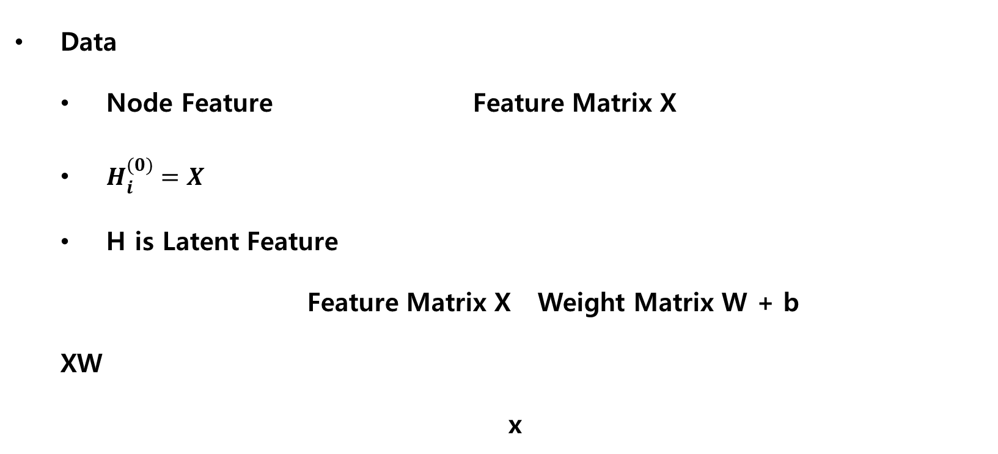
Graph Convolution
2
3
Data
Node Feature Feature Matrix X
$H_{i}^{(0)}=X$
H is Latent Feature
Feature Matrix X Weight Matrix W + b
XW
x
1
4
$H_{1}^{(l+1)}=σ(H_{1}^{\left(l\right)}W^{\left(l\right)}+H_{2}^{\left(l\right)}W^{(l)}$+ $H_{3}^{\left(l\right)}W^{(l)}$+ $H_{4}^{\left(l\right)}W^{(l)}+b^{(l)})$
2
3
1
4
https://github.com/heartcored98/Standalone-DeepLearning/blob/master/Lec9/Lec9-A.pdf

Slide 48
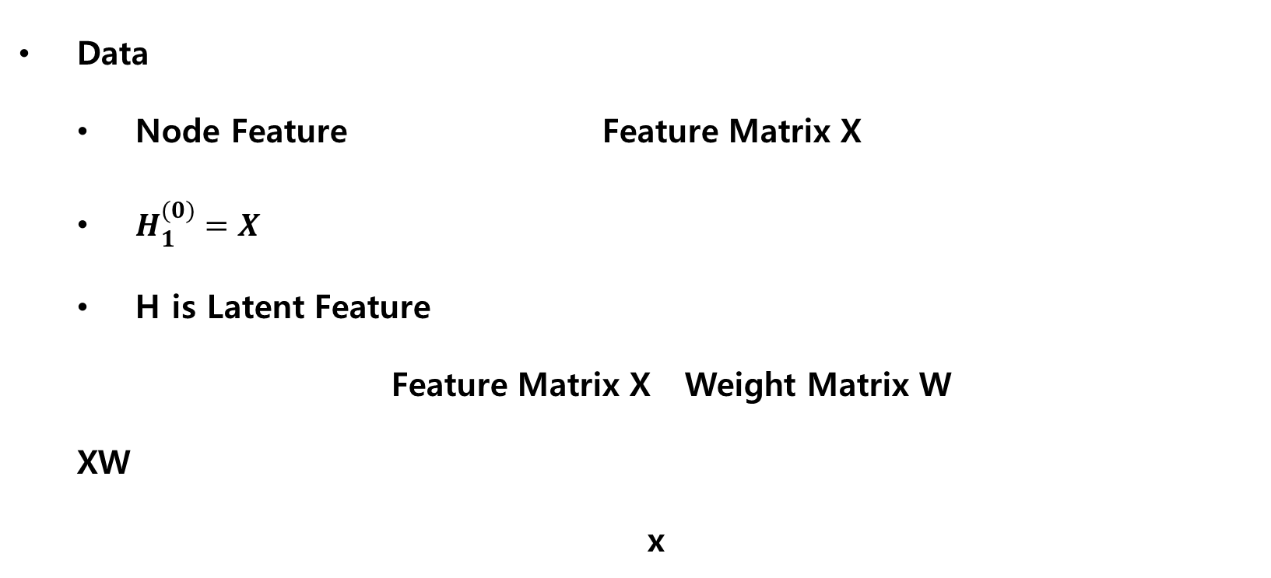
Graph Convolution
2
3
Data
Node Feature Feature Matrix X
$H_{1}^{(0)}=X$
H is Latent Feature
Feature Matrix X Weight Matrix W
XW
x
1
4
$H_{1}^{(l+1)}=σ(H_{1}^{\left(l\right)}W^{\left(l\right)}+H_{2}^{\left(l\right)}W^{(l)}$+ $H_{3}^{\left(l\right)}W^{(l)}$+ $H_{4}^{\left(l\right)}W^{(l)}+b^{(l)})$
2
3
1
4
https://github.com/heartcored98/Standalone-DeepLearning/blob/master/Lec9/Lec9-A.pdf

Slide 49
Graph Convolution
2
3
Data
Node Feature Feature Matrix X
Adjacency Matrix A
Node Label
1
4
 | 1 | 2 | 3 | 4
1 | 0 | 1 | 1 | 1
2 | 1 | 0 | 0 | 1
3 | 1 | 0 | 0 | 0
4 | 1 | 1 | 0 | 0
https://github.com/heartcored98/Standalone-DeepLearning/blob/master/Lec9/Lec9-A.pdf

Slide 50
Graph Convolution
2
3
Data
Node Feature Feature Matrix X
Adjacency Matrix A Feature Matrix X Weight Matrix W
AXW
x x
1
4
$H_{1}^{(l+1)}=σ(H_{1}^{\left(l\right)}W^{\left(l\right)}+H_{2}^{\left(l\right)}W^{(l)}$+ $H_{3}^{\left(l\right)}W^{(l)}$+ $H_{4}^{\left(l\right)}W^{(l)})$
0 | 1 | 1 | 1
1 | 0 | 0 | 1
1 | 0 | 0 | 0
1 | 1 | 0 | 0
2
3
1
4
https://github.com/heartcored98/Standalone-DeepLearning/blob/master/Lec9/Lec9-A.pdf

Slide 51
Graph Convolution
2
3
Data
Node Feature Feature Matrix X
Adjacency Matrix A A~ = A + I (Identity Matrix)
1
4
 | 1 | 2 | 3 | 4
1 | 0 | 1 | 1 | 1
2 | 1 | 0 | 0 | 1
3 | 1 | 0 | 0 | 0
4 | 1 | 1 | 0 | 0
 | 1 | 2 | 3 | 4
1 | 1 | 1 | 1 | 1
2 | 1 | 1 | 0 | 1
3 | 1 | 0 | 1 | 0
4 | 1 | 1 | 0 | 1
https://github.com/heartcored98/Standalone-DeepLearning/blob/master/Lec9/Lec9-A.pdf

Slide 52
Graph Convolution
2
3
Data
Node Feature Feature Matrix X
Adjacency Matrix A Feature Matrix X Weight Matrix W
A~XW
x x
1
4
$H_{1}^{(l+1)}=σ(H_{1}^{\left(l\right)}W^{\left(l\right)}+H_{2}^{\left(l\right)}W^{(l)}$+ $H_{3}^{\left(l\right)}W^{(l)}$+ $H_{4}^{\left(l\right)}W^{(l)})$
1 | 1 | 1 | 1
1 | 1 | 0 | 1
1 | 0 | 1 | 0
1 | 1 | 0 | 1
2
3
1
4
https://github.com/heartcored98/Standalone-DeepLearning/blob/master/Lec9/Lec9-A.pdf

Slide 53
Graph Convolution
2
3
Data
Node Feature Feature Matrix X
Degree Matrix D
1
4
 | 1 | 2 | 3 | 4
1 | 3 | 0 | 0 | 0
2 | 0 | 2 | 0 | 0
3 | 0 | 0 | 1 | 0
4 | 0 | 0 | 0 | 2
https://github.com/heartcored98/Standalone-DeepLearning/blob/master/Lec9/Lec9-A.pdf

Slide 54
Graph Convolution
2
3
Data
Node Feature Feature Matrix X
Degree Matrix D D~ = D + I
1
4
 | 1 | 2 | 3 | 4
1 | 3 | 0 | 0 | 0
2 | 0 | 2 | 0 | 0
3 | 0 | 0 | 1 | 0
4 | 0 | 0 | 0 | 2
 | 1 | 2 | 3 | 4
1 | 4 | 0 | 0 | 0
2 | 0 | 3 | 0 | 0
3 | 0 | 0 | 2 | 0
4 | 0 | 0 | 0 | 3
https://github.com/heartcored98/Standalone-DeepLearning/blob/master/Lec9/Lec9-A.pdf

Slide 55
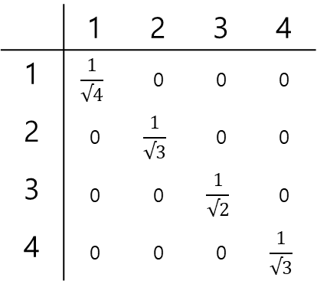
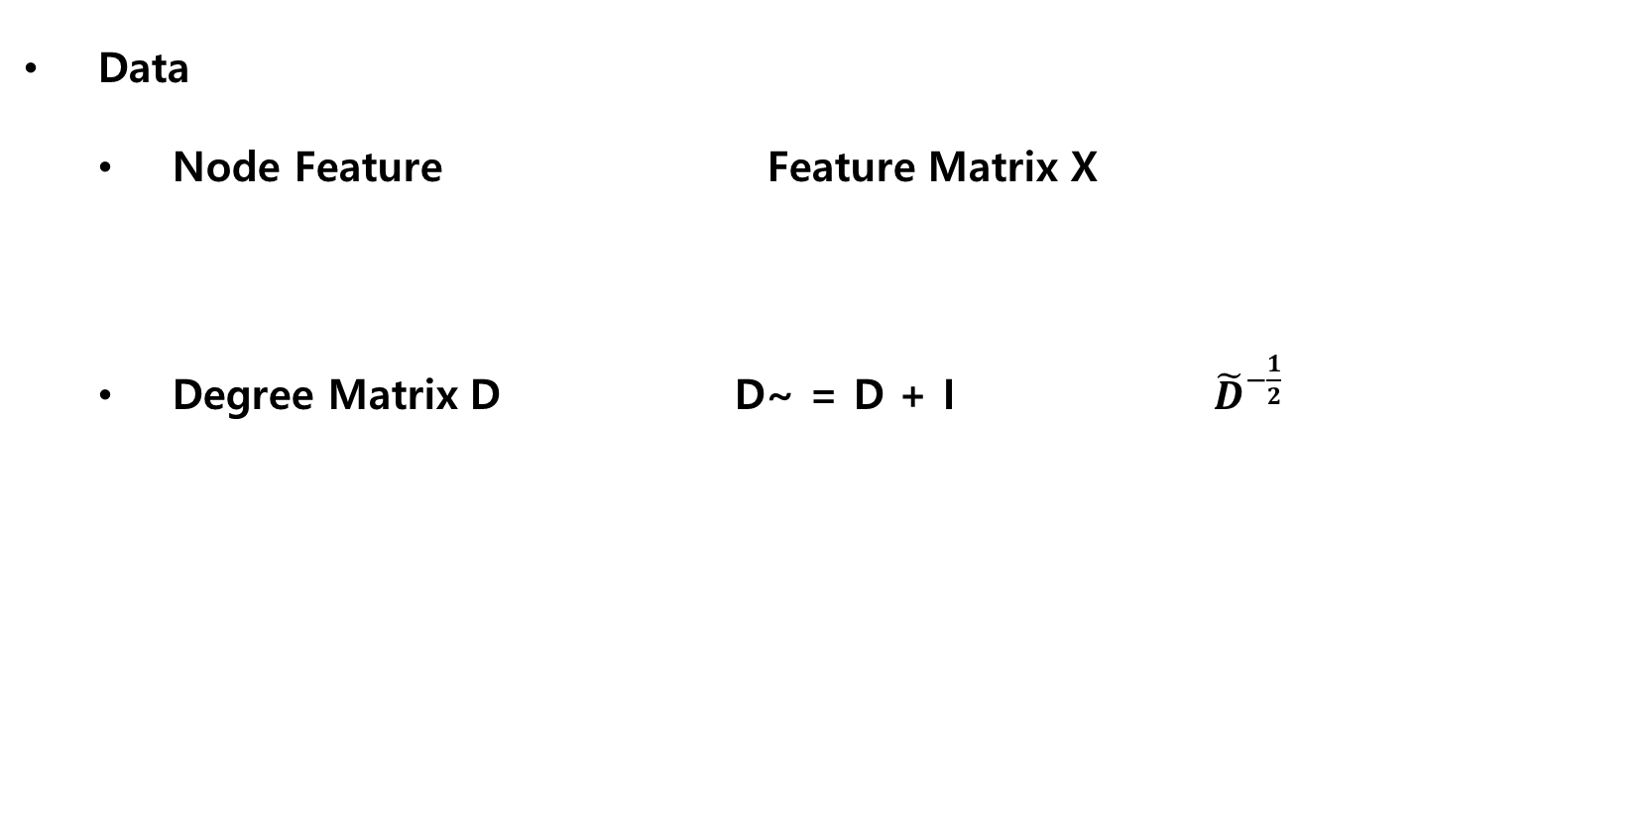
Graph Convolution
2
3
Data
Node Feature Feature Matrix X
Degree Matrix D D~ = D + I ${\tilde{D}}^{−\frac{1}{2}}$
1
4
 | 1 | 2 | 3 | 4
1 | 3 | 0 | 0 | 0
2 | 0 | 2 | 0 | 0
3 | 0 | 0 | 1 | 0
4 | 0 | 0 | 0 | 2
 | 1 | 2 | 3 | 4
1 | 4 | 0 | 0 | 0
2 | 0 | 3 | 0 | 0
3 | 0 | 0 | 2 | 0
4 | 0 | 0 | 0 | 3
 | 1 | 2 | 3 | 4
1 | $$\frac{1}{√4}$$ | 0 | 0 | 0
2 | 0 | $$\frac{1}{√3}$$ | 0 | 0
3 | 0 | 0 | $$\frac{1}{√2}$$ | 0
4 | 0 | 0 | 0 | $$\frac{1}{√3}$$
https://github.com/heartcored98/Standalone-DeepLearning/blob/master/Lec9/Lec9-A.pdf

Slide 56
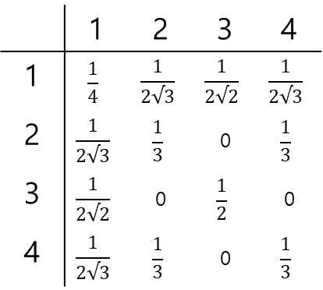
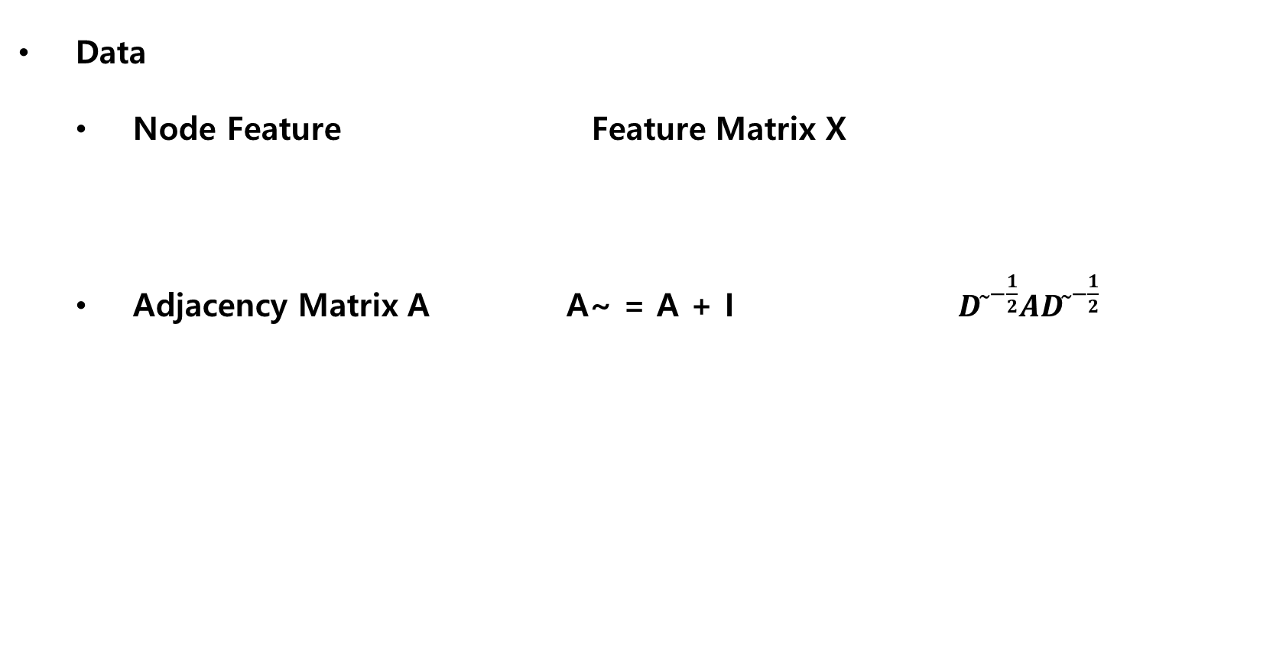
Graph Convolution
2
3
Data
Node Feature Feature Matrix X
Adjacency Matrix A A~ = A + I ${D ̃}^{−\frac{1}{2}}A{D ̃}^{−\frac{1}{2}}$
1
4
 | 1 | 2 | 3 | 4
1 | 0 | 1 | 1 | 1
2 | 1 | 0 | 0 | 1
3 | 1 | 0 | 0 | 0
4 | 1 | 1 | 0 | 0
 | 1 | 2 | 3 | 4
1 | 1 | 1 | 1 | 1
2 | 1 | 1 | 0 | 1
3 | 1 | 0 | 1 | 0
4 | 1 | 1 | 0 | 1
 | 1 | 2 | 3 | 4
1 | $$\frac{1}{4}$$ | $$\frac{1}{2√3}$$ | $$\frac{1}{2√2}$$ | $$\frac{1}{2√3}$$
2 | $$\frac{1}{2√3}$$ | $$\frac{1}{3}$$ | 0 | $$\frac{1}{3}$$
3 | $$\frac{1}{2√2}$$ | 0 | $$\frac{1}{2}$$ | 0
4 | $$\frac{1}{2√3}$$ | $$\frac{1}{3}$$ | 0 | $$\frac{1}{3}$$
https://github.com/heartcored98/Standalone-DeepLearning/blob/master/Lec9/Lec9-A.pdf

Slide 57
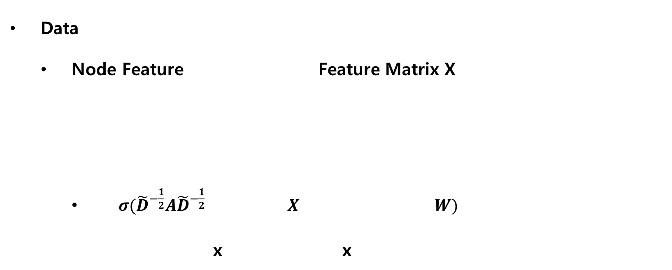
Graph Convolution
2
3
Data
Node Feature Feature Matrix X
$σ({\tilde{D}}^{−\frac{1}{2}}A{\tilde{D}}^{−\frac{1}{2}} X W)$
x x
1
4
$H_{1}^{(l+1)}=σ(H_{1}^{\left(l\right)}W^{\left(l\right)}+H_{2}^{\left(l\right)}W^{(l)}$+ $H_{3}^{\left(l\right)}W^{(l)}$+ $H_{4}^{\left(l\right)}W^{(l)})$
1 | 1 | 1 | 1
1 | 1 | 0 | 1
1 | 0 | 1 | 0
1 | 1 | 0 | 1
2
3
1
4
https://github.com/heartcored98/Standalone-DeepLearning/blob/master/Lec9/Lec9-A.pdf

Slide 58
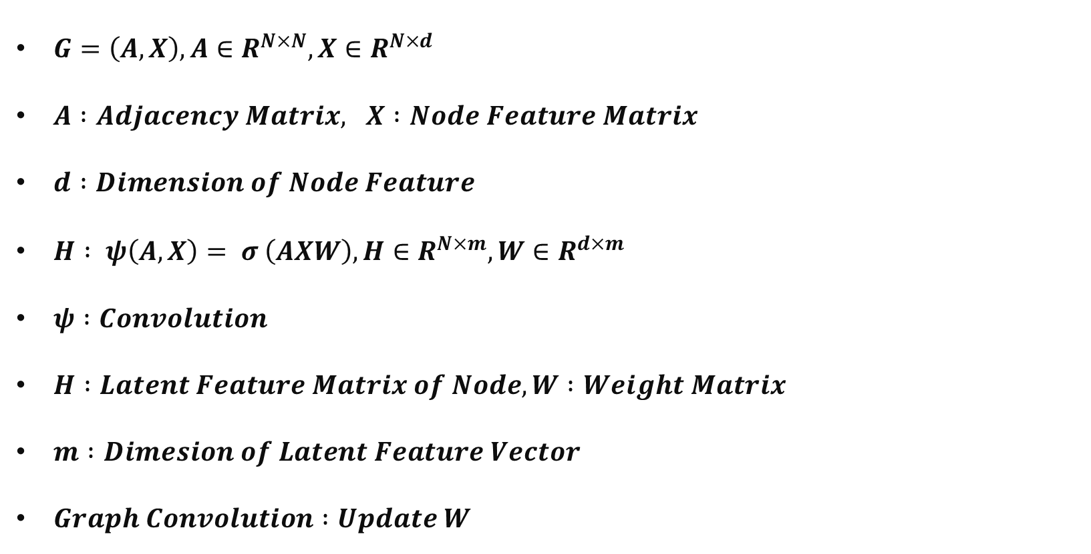
Graph Convolution
$G=\left(A, X\right), A∈R^{N×N}, X∈R^{N×d}$
$A :Adjacency Matrix, X :Node Feature Matrix$
$d :Dimension of Node Feature$
$H : ψ\left(A, X\right)= σ \left(AXW\right), H∈R^{N×m},W∈R^{d×m}$
$ψ :Convolution$
$H :Latent Feature Matrix of Node, W :Weight Matrix$
$m :Dimesion of Latent Feature Vector$
$Graph Convolution :Update W$

Slide 59
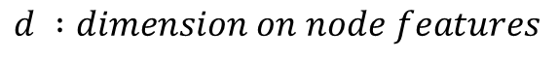
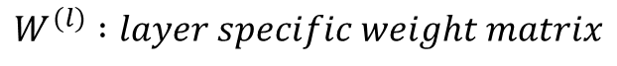
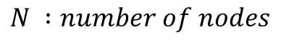
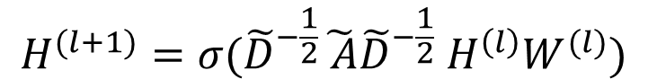
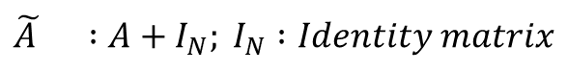
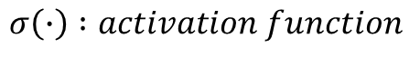
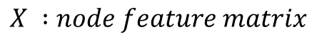
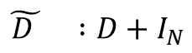
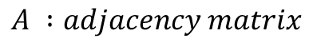
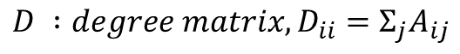
Layer-wise Graph Convolution
$$H^{(l+1)}=σ({\tilde{D}}^{−\frac{1}{2}}\tilde{ A}{\tilde{D}}^{−\frac{1}{2}} H^{\left(l\right)}W^{(l)})$$
$$G :graph, G=\left(A, X\right), A∈ℝ^{N×N},X∈ℝ^{N×d}$$
$$\tilde{A } :A+I_{N}; I_{N} :Identity matrix$$
$$A :adjacency matrix$$
$$\tilde{D } :D+I_{N}$$
$$N :number of nodes$$
$$H^{(l)} :Latent Feature matrix, H^{(l)}∈ℝ^{N×m}, H^{\left(0\right)}=X$$
$$d :dimension on node features$$
$$m :dimension on Latent Feature Matrix$$
$$X :node feature matrix$$
$$W^{(l)} :layer specific weight matrix$$
$$D :{degree matrix, D}_{ii}=Σ_{j}A_{ij}$$
$$σ\left(∙\right) :activation function$$

Slide 60
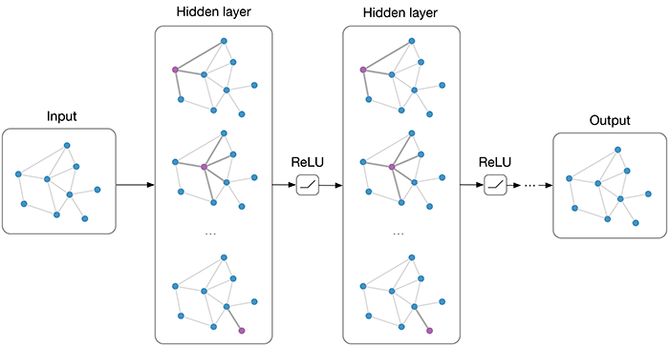
Graph Convolution Layers
3
2
3
2
1
2
3rd layer
2nd layer
1st layer
3
2
1
A
1
2
$$Z=sigmoid(\hat{A} ReLU(\hat{A} ReLU\left(\hat{A}XW^{\left(0\right)}\right)W^{\left(1\right)})W^{\left(2\right)})$$
3
2
Sigmoid
1st layer 2nd layer 3rd layer

Slide 61
Graph Convolution Network
Readout Layer
CNN Pooling Layer → Translation Invariance
https://tkipf.github.io/graph-convolutional-networks/

Slide 62
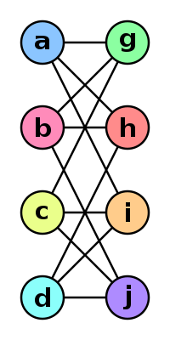
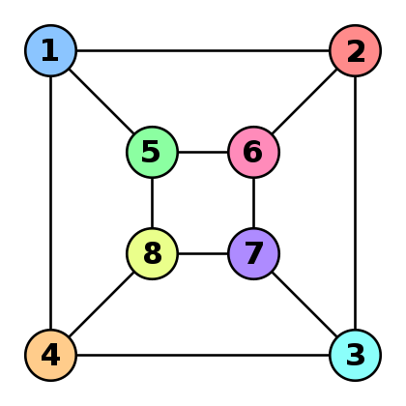

Graph Convolution Network
Readout Layer
CNN Pooling Layer → Translation Invariance
GCN Readout Layer → Isomorphism Invariance
https://github.com/heartcored98/Standalone-DeepLearning/blob/master/Lec9/Lec9-A.pdf

Slide 63

Graph Convolution Network
Readout Layer
CNN Pooling Layer → Translation Invariance
GCN Readout Layer → Isomorphism Invariance
https://github.com/heartcored98/Standalone-DeepLearning/blob/master/Lec9/Lec9-A.pdf

Slide 64
QUESTION?

Slide 65
Contents
1. Introduction
a. Deep Learning
b. Convolutional Neural Network
c. Graph Neural Network
2. Graph Convolution
3. Spectral vs Spatial Convolution
a. Fourier Transform
b. Laplacian to Fourier Transform
4. Cluster-GCN
a. Gradient Descent
b. Cluster-GCN
5. Application
a. Two-hand Reconstruction
6. References

Slide 66
Graph Convolution
Spatial vs Spectral
Spatial Convolution
Update feature of central unit (node, pixel) with its neighbor’s features
Less computation compared to Spectral Convolution
Spectral Convolution
Graph Signal Processing
Feature extracting by noise removal
Filtering / Fourier Transform
Spectral Convolution → Spatial Convolution

Slide 67
Graph Convolution
Spatial vs Spectral
Spatial Graph Convolution
Update feature of central unit (node, pixel) with its neighbor’s features
2
3
1
4
N=0

Slide 68
Graph Convolution
Spatial vs Spectral
Spatial Graph Convolution
Update feature of central unit (node, pixel) with its neighbor’s features
2
3
2
3
1
1
4
4
N=0
N=1

Slide 69
Graph Convolution
Spatial vs Spectral
Spatial Graph Convolution
Update feature of central unit (node, pixel) with its neighbor’s features
2
3
2
3
2
3
1
1
1
4
4
4
N=0
N=1
N=2

Slide 70
Graph Convolution
Spatial vs Spectral
Spatial Graph Convolution
Update feature of central unit (node, pixel) with its neighbor’s features
Elements from different nodes are mixed
2
3
2
3
2
3
1
1
1
4
4
4
N=0
N=1
N=2

Slide 71


Fourier Transform
In spectral analysis, Fourier Transform transforms time/space domain signal to frequency domain

Slide 72

Fourier Transform
In spectral analysis, Fourier Transform transforms time/domain signal to frequency domain
Fourier Transform & Convolution
Convolution Theorem
Fourier transform of a convolution of two functions (or signals) is the pointwise product of their Fourier transforms

Slide 73
2
3
Graph Fourier Transform
1
4
Graph node feature into elements
Spatial : Mixed elements in node feature by message passing ☞ Spatial Convolution
Frequency : Filter signals that can be node feature ☞ Spectral Convolution
Spatial Convolution
Spectral Convolution

Slide 74

Fourier Transform
$f\left(x\right)=\int_{−∞}^{∞}{ℱ\left(u\right)e^{j2πux}du=\int_{−∞}^{∞}{ℱ\left(u\right)\{\cos{2πux+j\sin{2πux}}\}du}}$
{Integral of (multiplication of function)} is same with function inner product
$\int_{−∞}^{∞}{f\left(x\right)g\left(x\right)dx }$
$x=1, 2, 3, \vec{f}=\left\{f_{1}, f_{2}, f_{3}\right\}, \vec{g}=\left\{g_{1}, g_{2}, g_{3}\right\}$
$\vec{f} ° \vec{g}=f_{1}g_{1}+f_{2}g_{2}+f_{3}g_{3}=\sum_{x=1}^{3}{f_{x}g_{x}}$ → $\int_{−∞}^{∞}{f\left(x\right)g\left(x\right)dx }$
$\int_{−∞}^{∞}{ℱ\left(u\right)\{\cos{2πux+j\sin{2πux}}\}du}$ = inner product of $ℱ\left(u\right)$ and $\{\cos{2πux+j\sin{2πux}}\}$
https://phy64ev1.tistory.com/16

Slide 75


https://commons.wikimedia.org/wiki/File:Sine_and_cosine_animation.gif
Fourier Transform
Inner product = similarity
Sine and Cosine is orthogonal
$f\left(x\right)=\int_{−∞}^{∞}{ℱ\left(u\right)e^{j2πux}du=\int_{−∞}^{∞}{ℱ\left(u\right)\{\cos{2πux+j\sin{2πux}}\}du}}$
Inner product of {elements gained by Fourier Transform} and {orthogonal elements}
= Vector Decomposition into orthogonal basis
= Eigendecomposition of matrix

Slide 76

Fourier Transform
https://en.wikipedia.org/wiki/Eigenvalues_and_eigenvectors
Inner product = similarity
Sine and Cosine is orthogonal
$f\left(x\right)=\int_{−∞}^{∞}{ℱ\left(u\right)e^{j2πux}du=\int_{−∞}^{∞}{ℱ\left(u\right)\{\cos{2πux+j\sin{2πux}}\}du}}$
Inner product of {elements gained by Fourier Transform} and {orthogonal elements}
= Vector Decomposition into orthogonal basis
= Eigendecomposition of matrix

Slide 77





Graph Laplacian
Laplace Operator $∆f= ∇∙∇f=∇^{2}f$
Laplacian is divergence of gradient
f
Gradient of f
Divergence of Gradient of f
https://ralasun.github.io/deep%20learning/2021/02/15/gcn/

Slide 78


Graph Laplacian
Laplace Operator $∆f= ∇∙∇f=∇^{2}f$
Laplacian is divergence of gradient
Laplacian is similar to second partial derivative
In graph signal, Laplacian is the same with amount of diffusion of a signal
https://ralasun.github.io/deep%20learning/2021/02/15/gcn/

Slide 79


Graph Fourier Transform
Laplace Operator $∆f= ∇∙∇f=∇^{2}f$
Laplacian is divergence of gradient
Laplacian is similar to second partial derivative
In graph signal, Laplacian is the same with amount of diffusion of a signal
Graph Laplacian = difference in signal between nodes (frequency)
Graph Laplacian → Eigendecomposition = Graph Fourier Transform
Graph Laplacian → Eigendecomposition → Chebyshev polynomial = Spectral Graph Convolution = Layer-wise Graph Convolution
https://ralasun.github.io/deep%20learning/2021/02/15/gcn/

Slide 80

Graph Fourier Transform
Laplace Operator $∆f= ∇∙∇f=∇^{2}f$
Laplacian is divergence of gradient
Laplacian is similar to second partial derivative
In graph signal, Laplacian is the same with amount of diffusion of a signal
Graph Laplacian = difference in signal between nodes (frequency)
Graph Laplacian → Eigendecomposition = Graph Fourier Transform
Graph Laplacian → Eigendecomposition → Chebyshev polynomial = Spectral Graph Convolution = Layer-wise Graph Convolution
a localized first-order approximation of spectral graph convolutions.
https://ralasun.github.io/deep%20learning/2021/02/15/gcn/

Slide 81
Contents
1. Introduction
a. Deep Learning
b. Convolutional Neural Network
c. Graph Neural Network
2. Graph Convolution
3. Spectral vs Spatial Convolution
a. Fourier Transform
b. Laplacian to Fourier Transform
4. Cluster-GCN
a. Gradient Descent
b. Cluster-GCN
5. Application
a. Two-hand Reconstruction
6. References

Slide 82



Gradient Descent
In Limitations and Future work..
Gradient Descent
Way to find minimum of cost function
Repeat until convergence {
$θ_{j}≔θ_{j}−α\frac{∂}{∂θ_{j}}J\left(θ_{0},θ_{1}\right)$
$\left(for j=1 and j=0\right)$ }

Slide 83

Gradient Descent
(Full) Batch Gradient Descent
Use all samples at a step in training data set
Smooth, but slow
Local minimum problem
Stochastic Gradient Descent
1 sample at a step
Fast. Shooting.
Cat get out of local minimum
Hard to find global minimum

Slide 84
Gradient Descent
Mini-batch (Stochastic) Gradient Descent
{Data Size} / {Batch Size} samples at a step
mean gradient
Less memory than BGD
More memory than SGD

Slide 85
Gradient Descent
In Limitations and Future work..
Traditional GCN (Full-batch Gradient Descent)
Store all the intermediate embeddings
Convergence of gradient descent is slow
[memory: bad; time per epoch: good; convergence: bad]

Slide 86
Gradient Descent
GCN with Mini-batch Gradient Descent
reduce the memory requirement
many updates per epoch
faster convergence.
neighborhood expansion problem
[memory: good; time per epoch: bad; convergence: good]

Slide 87
Gradient Descent
3
2
3
2
1
2
GCN with Mini-batch Gradient Descent
reduce the memory requirement
many updates per epoch
faster convergence.
neighborhood expansion problem
[memory: good; time per epoch: bad; convergence: good]
3
2
1
A
1
2
3
2

Slide 88
Gradient Descent
GCN with Mini-batch Gradient Descent
reduce the memory requirement
many updates per epoch
faster convergence.
neighborhood expansion problem
[memory: good; time per epoch: bad; convergence: good]

Slide 89
Gradient Descent
GCN with Mini-batch Gradient Descent
reduce the memory requirement
many updates per epoch
faster convergence.
neighborhood expansion problem
[memory: good; time per epoch: bad; convergence: good]

Slide 90
Gradient Descent
GCN with Mini-batch Gradient Descent
reduce the memory requirement
many updates per epoch
faster convergence.
neighborhood expansion problem
[memory: good; time per epoch: bad; convergence: good]

Slide 91
Gradient Descent
GCN with Mini-batch Gradient Descent
reduce the memory requirement
many updates per epoch
faster convergence.
neighborhood expansion problem → exponentially increasing num of nodes
[memory: good; time per epoch: bad; convergence: good]

Slide 92


Cluster GCN
Clustering (METIS) → Subgraphs
GCN processed in subgraphs
$𝓥=\left[𝓥_{1}, ⋯,𝓥_{c}\right], G=\left[G_{1}, ⋯,G_{c}\right]=\left[\left\{𝓥_{1},𝓔_{1}\right\},⋯,\left\{𝓥_{c},𝓔_{c}\right\}\right\}$
$A=\overline{A}+Δ=\left[\begin{matrix}A_{11} & ⋯ & 0 \\ ⋮ & ⋱ & ⋮ \\ 0 & ⋯ & A_{cc}\end{matrix}\right]+\left[\begin{matrix}0 & ⋯ & A_{1c} \\ ⋮ & ⋱ & ⋮ \\ A_{c1} & ⋯ & 0\end{matrix}\right]$

Slide 93

Cluster GCN
$Z^{(L)}=$ $\overline{A^{′}}σ\left(\overline{A^{′}}σ\left(⋯σ\left(\overline{A^{′}}XW^{\left(0\right)}\right)W^{\left(1\right)}\right)⋯\right)W^{(L−1)}$
$=\left[\begin{matrix}\begin{aligned}\overline{A_{11}^{′}}σ\left(\overline{A_{11}^{′}}σ\left(⋯σ\left(\overline{A_{11}^{′}}X_{1}W^{\left(0\right)}\right)W^{\left(1\right)}\right)⋯\right)W^{(L−1)} \\ ⋮\end{aligned} & \begin{aligned} \\ W^{(L−1)}\end{aligned} \\ \overline{A_{cc}^{′}}σ\left(\overline{A_{cc}^{′}}σ\left(⋯σ\left(\overline{A_{cc}^{′}}X_{c}W^{\left(0\right)}\right)W^{\left(1\right)}\right)⋯\right) & \end{matrix}\right]$
GCN Decomposition into subgraphs

Slide 94
Contents
1. Introduction
a. Deep Learning
b. Convolutional Neural Network
c. Graph Neural Network
2. Graph Convolution
3. Spectral vs Spatial Convolution
a. Fourier Transform
b. Laplacian to Fourier Transform
4. Cluster-GCN
a. Gradient Descent
b. Cluster-GCN
5. Application
a. Two-hand Reconstruction
6. References

Slide 95

Application
<Interacting Attention Graph for Single Image Two-Hand Reconstruction>
Two-Hand Reconstruction

Slide 96


Application
Attention : Attention is all you need (transformer)

Slide 97
Application
https://youtu.be/FdqRiNFG1qg

Slide 98
References
<Semi-Supervised Classification with Graph Convolutional Networks>
Thomas N. Kipf, Max Welling / ICLR 2017 https://arxiv.org/abs/1609.02907
<Cluster-GCN: An Efficient Algorithm for Training Deep and Large Graph Convolutional Networks>
Chiang et al. / ACM SIGKDD 2019 https://arxiv.org/abs/1905.07953
<Interacting Attention Graph for Single Image Two-Hand Reconstruction>
Li et al. / CVPR 2022 https://arxiv.org/abs/2203.09364
<Deep Learning> Ian Goodfellow, Yoshua Bengio, and Aaron Courville

Slide 99
Thank
You
감사합니다.

